Slide 1

Tableau Desktop 200 Level
February 3rd, 2017

Slide 2
About Me
Name: Patrick McDevitt
Background: Duquesne University (Economics), Evoke Research and Consulting, Deloitte Consulting
Experience with Tableau: ~2 years self-taught
Fun Fact: College book-club participant and avid golfer

Slide 3
Contents
Course Overview 3
Tableau Background 6
Basic Features 15
Chart Types 27
Intermediate Features 49
Appendix A: Visual Cues 65
Appendix B: Glossary 68

Slide 4
Course Overview

Slide 5
Course Description and Goals
Course Description
This course will introduce users to Tableau to tell rich stories with data. The activities in this course will lead to the development of a Tableau dashboard.
Course Goals
To teach students how to connect to data, design visualizations and build interactive dashboards. Users should have a basic understanding of Tableau features including formatting, actions, calculated fields, hierarchies, groups, filters, reference lines and a variety of visualization types.

Slide 6
Course Objectives
After completing this course, learners will be able to:
Import multiple types of data sources
Understand basic controls and navigations of the tool
Create hierachies and groups
Be able to pick the right visualization for your data type
Understand the basic formatting features of Tableau
Use action filters and highlights
Incorporate parameters into your visualizations
Build an interactive dashboard

Slide 7
Tableau Background

Slide 8
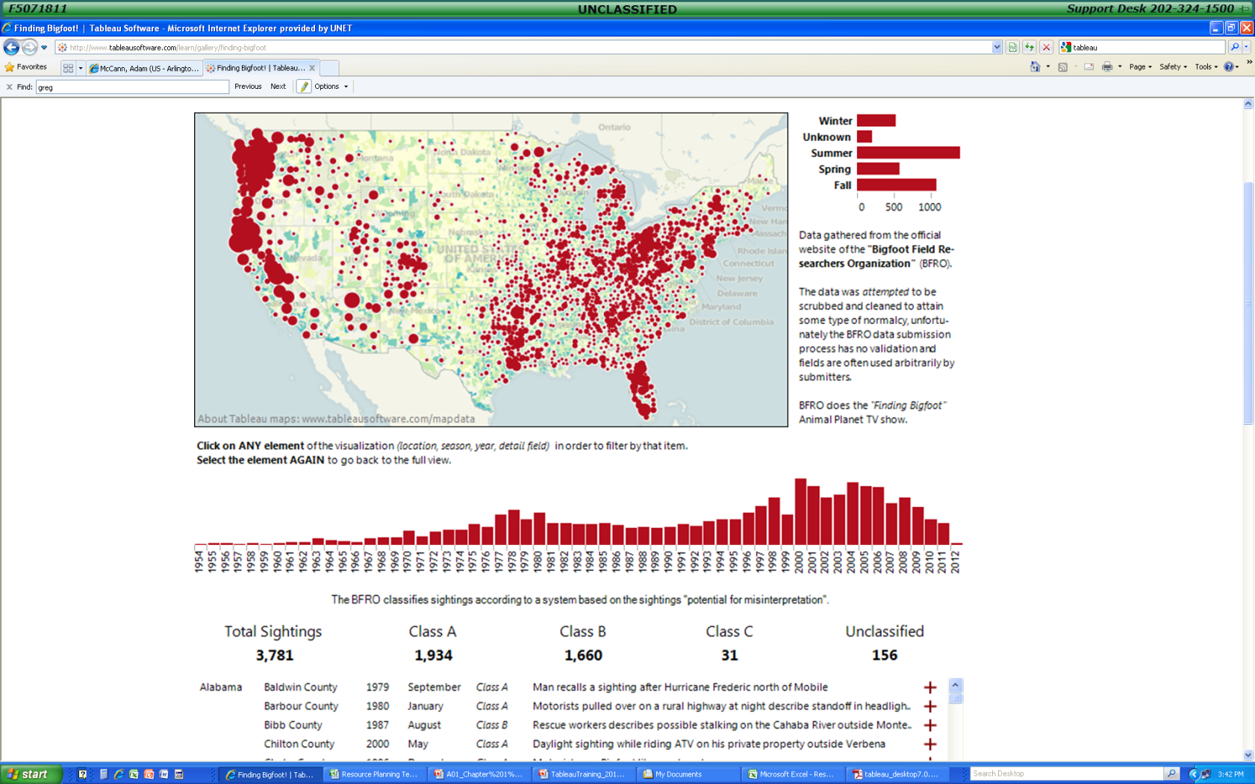
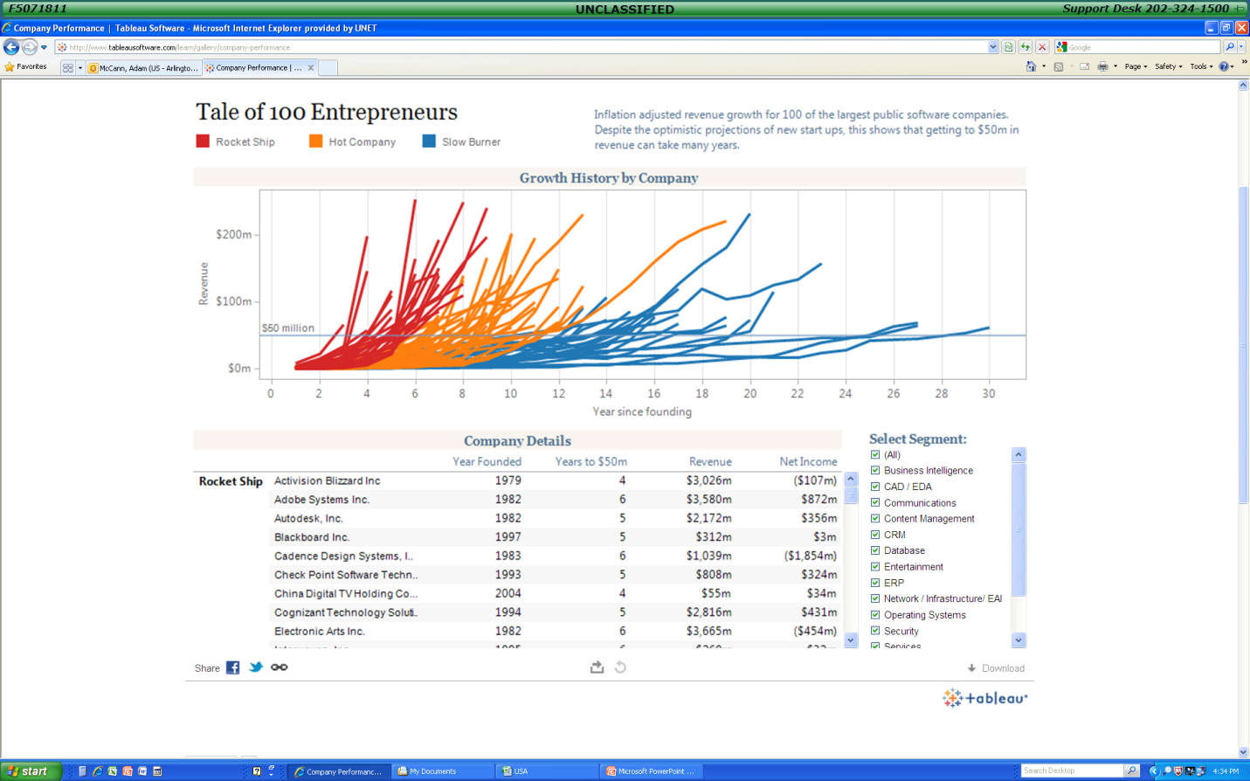
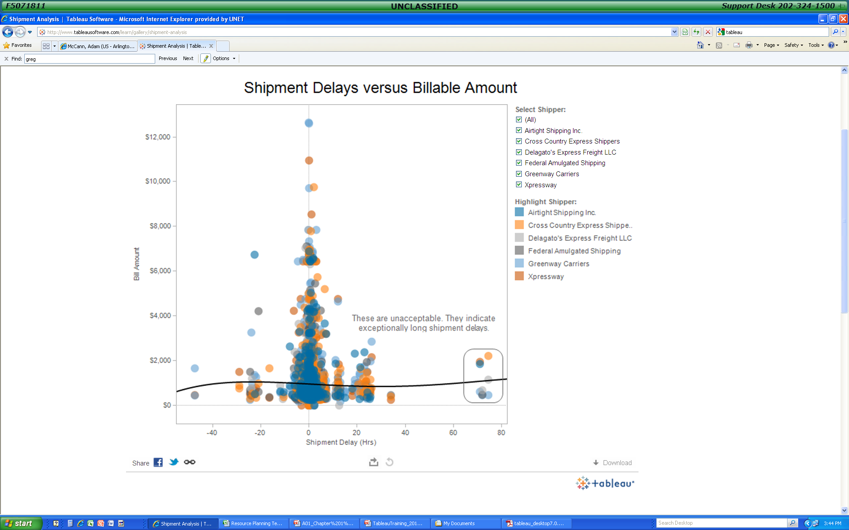
Tableau Background
Tableau Software provides software applications for fast analytical and rapid fire business intelligence.
Tableau Desktop is a data visualization application that lets you analyze virtually any type of structured data and produce highly interactive, beautiful graphs, dashboards, and reports in just minutes.
You can connect to virtually any data source from spreadsheets to data warehouses and display information in multiple graphic perspectives.

Slide 9
Tableau is an Excellent Tool For Organizing Visual Data
Ease of Use
Designed for Comparison & Patterns
Plug and play with data sets, no scripting required
Link tables to create relational entities
Drag & drop layout, no programming required
Specifically designed layouts for
Time series
Comparative functions
Pattern analysis
High Data to Ink Ratio
Excellent Engine
Supports multivariate analysis (X by Y by Z) in a variety of formats
Bubble charts
Spark lines
Bullet Charts
Highlighting settings cue up data pre-attentiveness
Expose parameters for event modeling in real time
Creates dashboards by embedding multiple visualizations into a single entity
Supports SQL like equation builder
Creates running totals, percent of, moving average, etc on the fly
Supports a high level of dynamic use “out of the box”
Embeds background data in table format for on the fly details
These factors change the delivery from a presentation to a conversation.

Slide 10
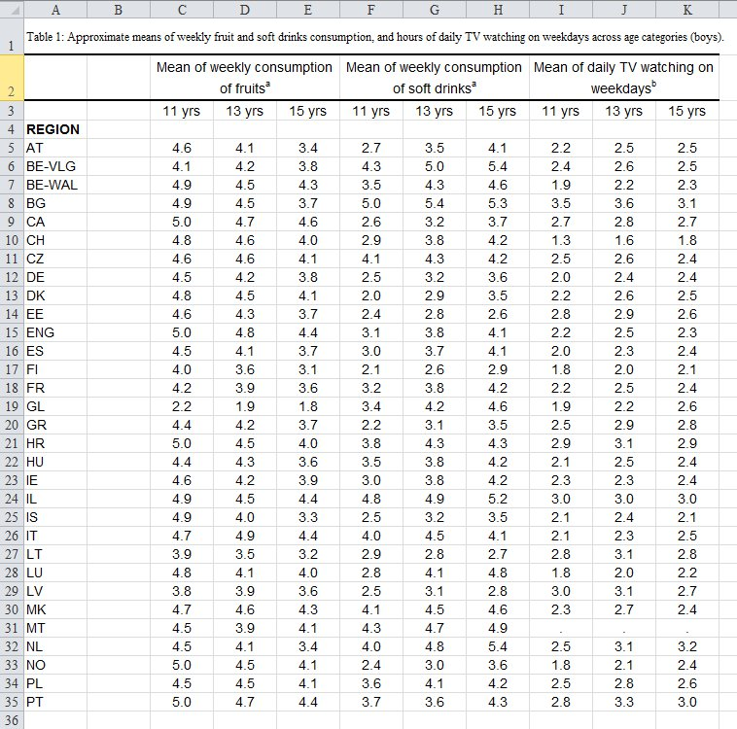
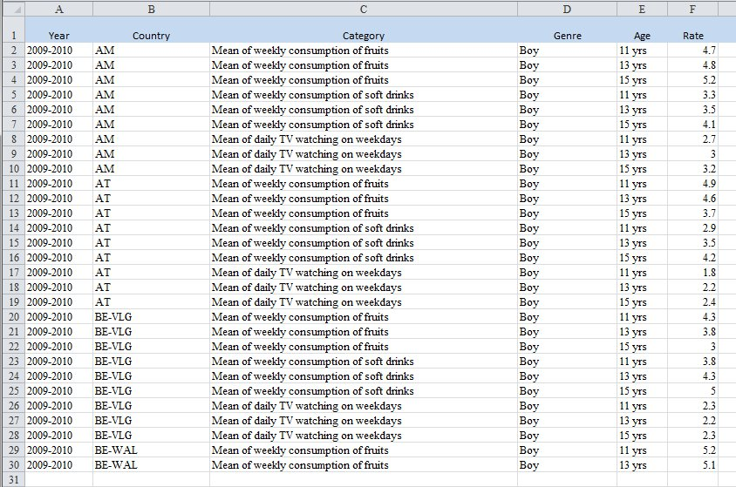
Preparing Data
Cleaning – Remove errors/noise, extraneous columns, normalizing
Integration – Blending multiple data sets either in Tableau or Database
Transformation – Preparing data structure for Tableau, Excel Reshaper
BAD DATA
WIDE
REDUNDANT COLUMNS
BADLY FORMATED
NULLS GALORE!
GOOD DATA
TALL
UNIQUE COLUMNS
NO EXTRA ROWS
CLEAN NULLS

Slide 11
About the Data
For this presentation we are going to be using Capital Trip History BikeShare data
On a quarterly basis, Capital BikeShare releases the data associated with every trip that has taken place. Found HERE
The original column headers are the following:
Using Python and the Google API we can call the exact longitude and latitude of each station number, as well as the zip code
This dataset contains 1,048,576 unique BikeShare trips from 2011.
Duration (ms) | Start date | End date | Start station number | Start station | End station number | End station | Bike number | Member Type
301295 | 3/31/2016 23:59 | 4/1/2016 0:04 | 31280 | 11th & S St NW | 31506 | 1st & Rhode Island Ave NW | W00022 | Registered
Bike | Duration | End_date | End_station | Start_date | Start_station | Type | End_latitude | End_longitude | End_ZIP | Start_latitude | Start_longitude | Start_ZIP
W00749 | 1 | 4/1/2011 0:00 | 16th & Harvard St NW | 3/31/2011 23:58 | 14th & Harvard St NW | Registered | 38.9262766 | -77.0364703 | 20009 | 38.9265705 | -77.0324193 | 20009

Slide 12
Tableau Demo

Slide 13
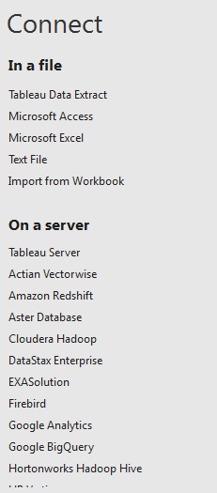
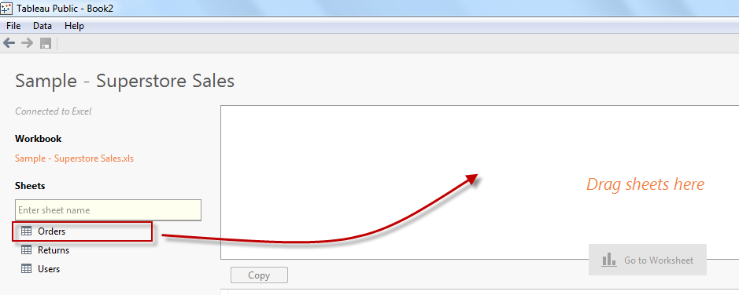
Getting Started: Connecting to Data
Click Connect to Data on left side of page
Select data source type
Navigate to file you want to connect to
Select how you to want to connect to data:
Live: Direct connect to data. Slows speeds but allows you make updates to source.
Import: Brings in data to workbook. Improves speed.
1
2
3

Slide 14
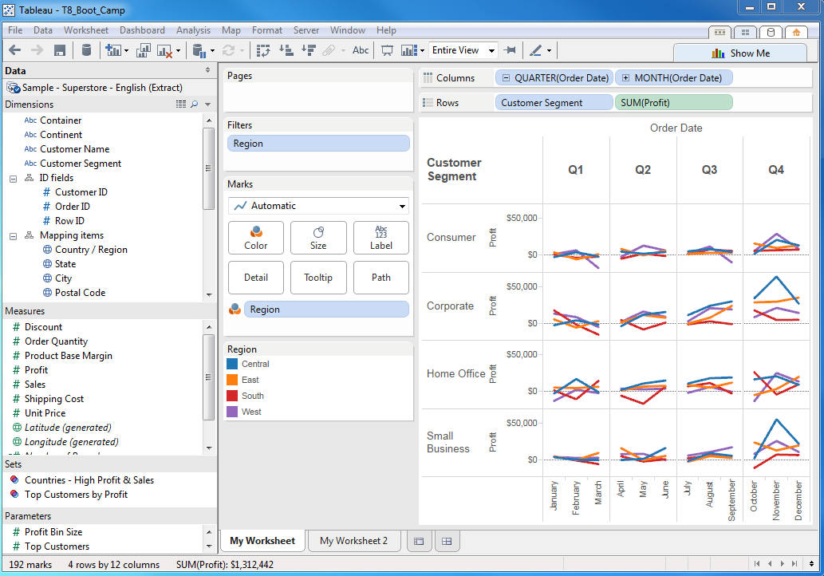
Screen Basics
Data Connect
Quick Sort
Worksheet
Data Window
View Cards
Labels
Workspace Controls
Quick Chart
Preview
Dimensions
Text/Categories
Chart
View
Measures
Numbers
Sets
Dimension
Groups
Status Bar
Worksheet Tabs
Sheet Sorter

Slide 15
Card Details
Columns Shelf – where you can drag fields to add columns to the view
Rows Shelf – where you can drag fields to add columns to the view
Pages Shelf – create several different pages with respect to the members in a dimension or the values in a measure
Filters Shelf – contains the Filters shelf; use this shelf to specify the values to include in the view
Measure Values Shelf – use this shelf to use multiple measures along a single axis
Quick Filters – use these cards to easily include and exclude values from the view
Parameters – use these cards to modify parameter values
Marks – contains a mark selector where you can specify the mark type as well as the Path, Shape, Text, Color, Size, Angle, and Level of Detail shelves. NOTE: The availability of these shelves are dependent on the fields in the view
Title – contains the title for the view. Double–click this card to modify the title
Caption – contains a caption that describes the view. Double–click this card to modify the caption
Summary – contains summary of each of the measures in the view including the Min, Max, Sum, and Average

Slide 16
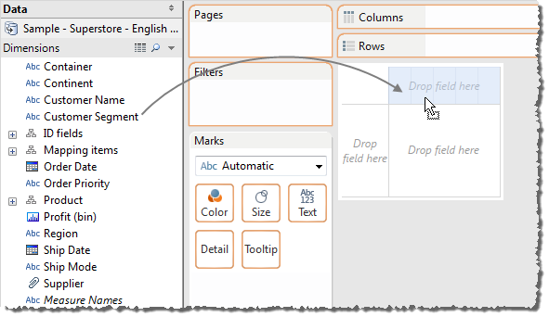
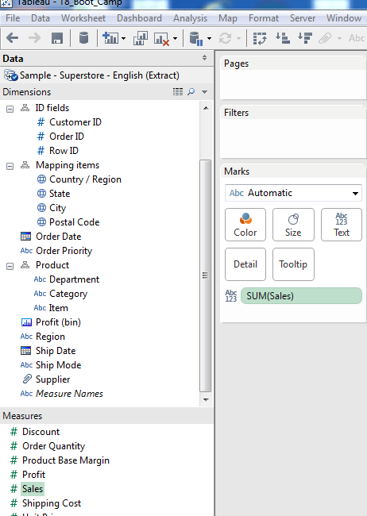
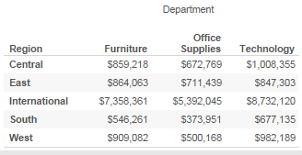
Getting Started: Drag a Dimension and Measure
Drag a Dimension
Drag a Measure

Slide 17
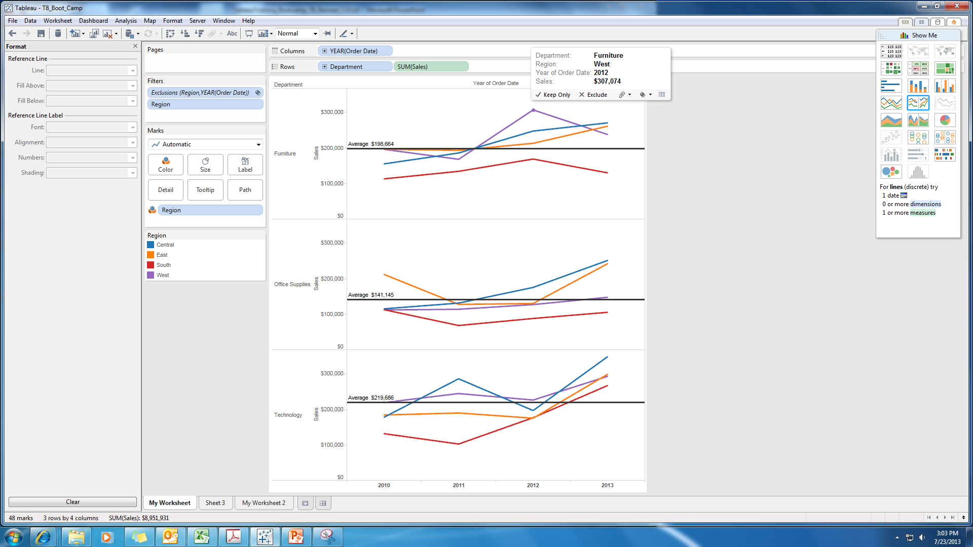
Activity #1 Experiment and Build a Worksheet – 5 Minutes

Slide 18
Basic Features

Slide 19
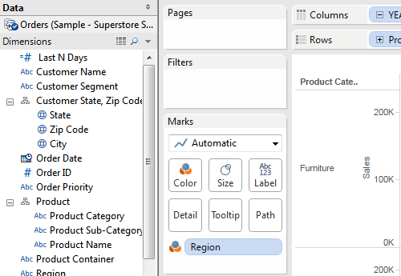
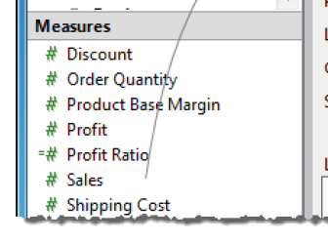
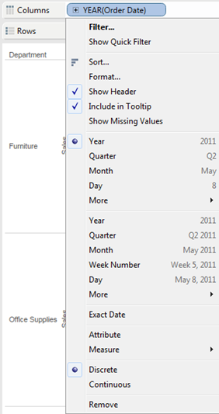
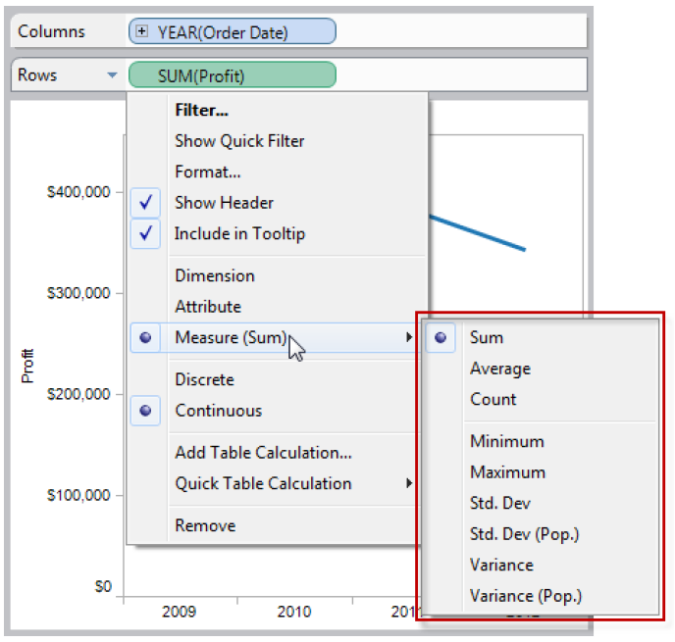
Dimension and Measures
# Categories
Calculated Field
Hierarchy
Dates
Geo–Coded
Discrete
Continuous
Aggregation Type

Slide 20
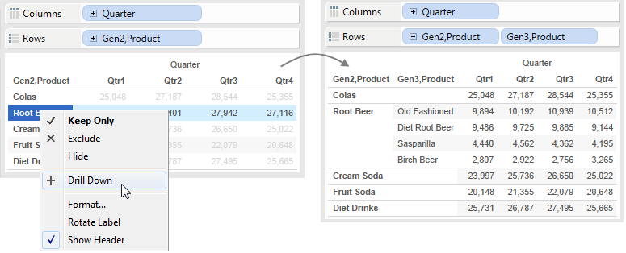
Drilling Down

Slide 21
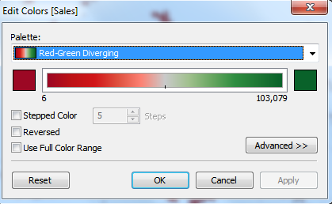
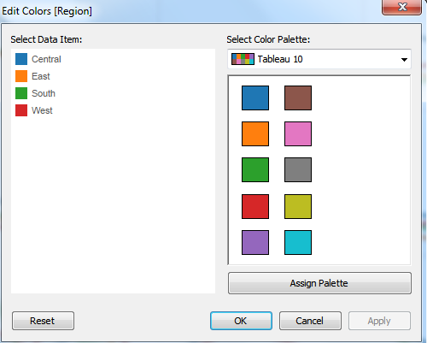
Colors
Quantitative / Scalar Colors
Categorical / Nominal Colors

Slide 22
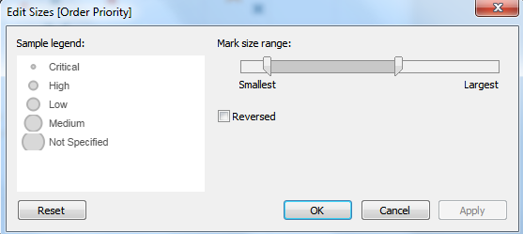
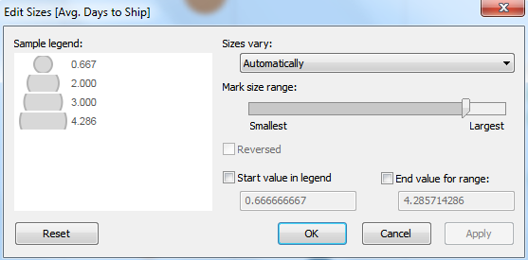
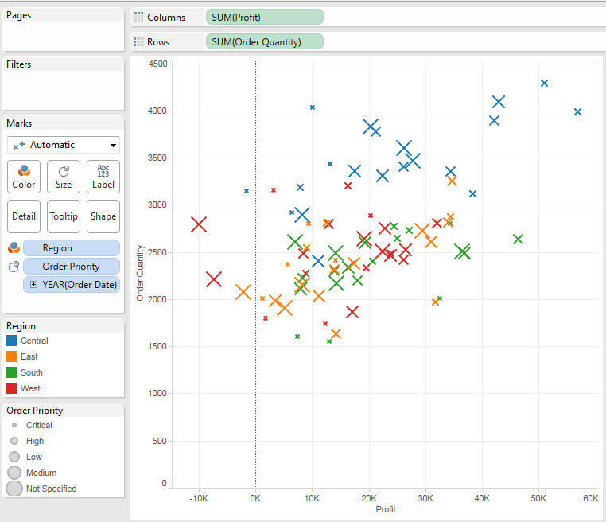
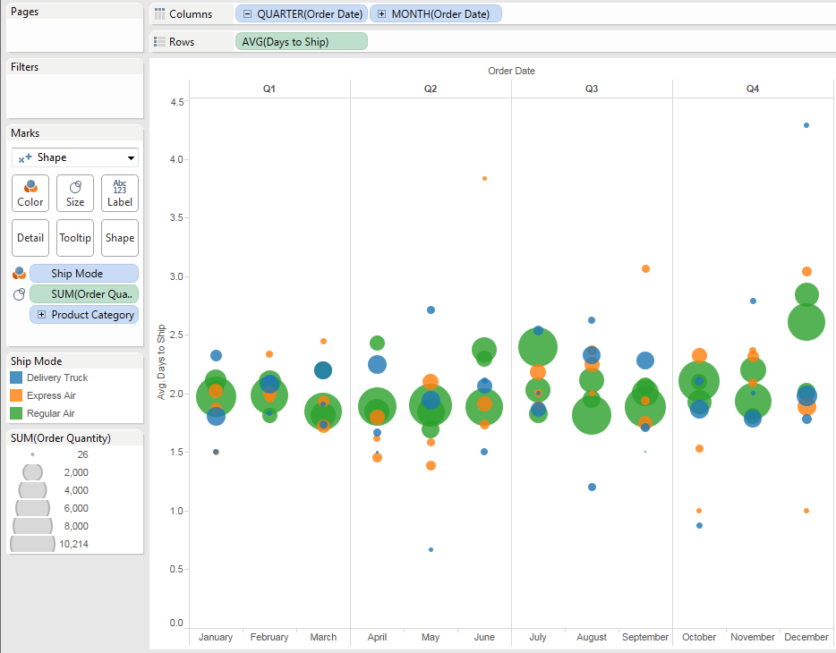
Size
Categorical Size
Quantitative Size

Slide 23
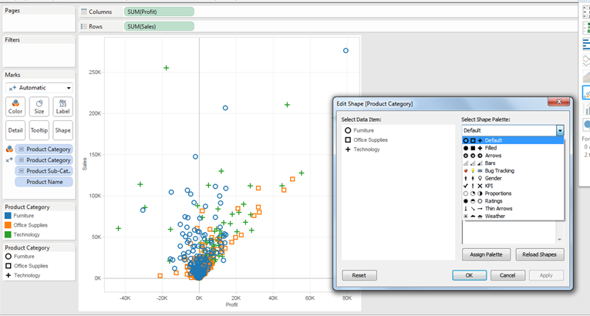
Shapes
Have the ability to add custom shapes

Slide 24
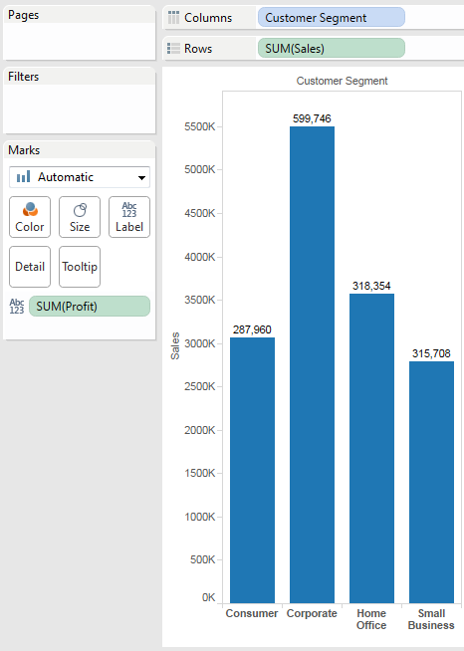
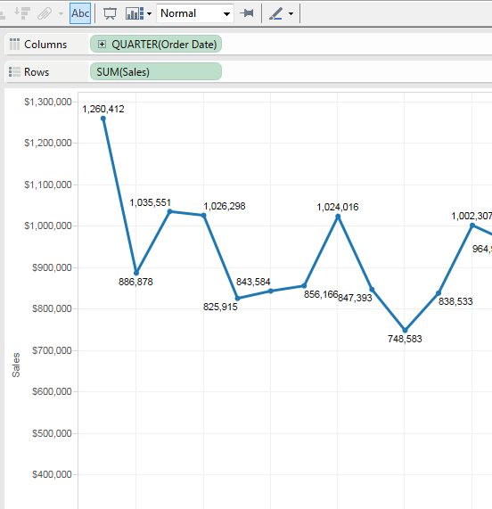
Labels
Quick Mark Labels

Slide 25
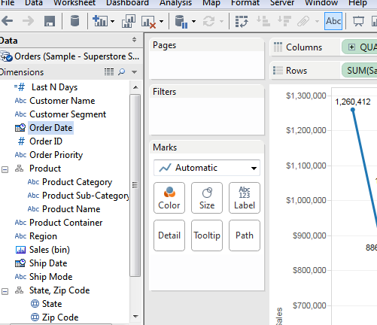
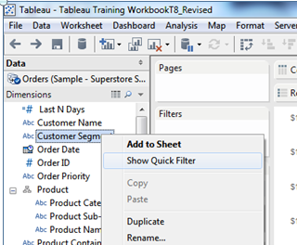
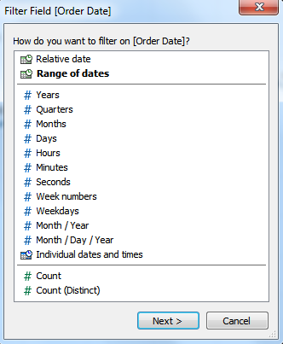
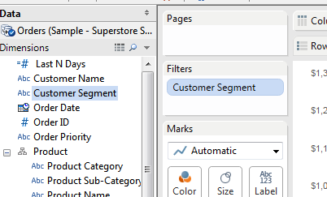
Filters
Drag and Drop to Card or…..
Right-Click on Measure/Dimension
1
3
2

Slide 26
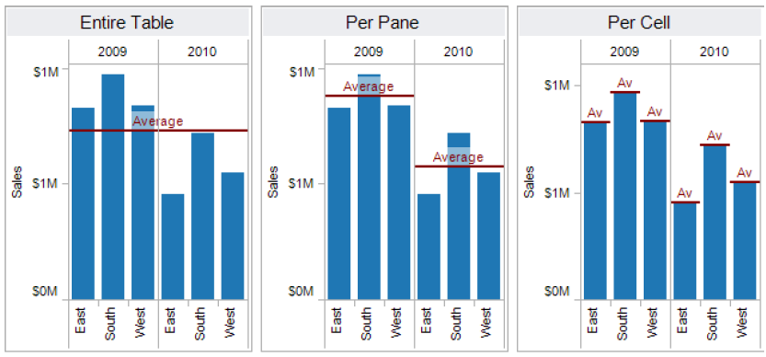
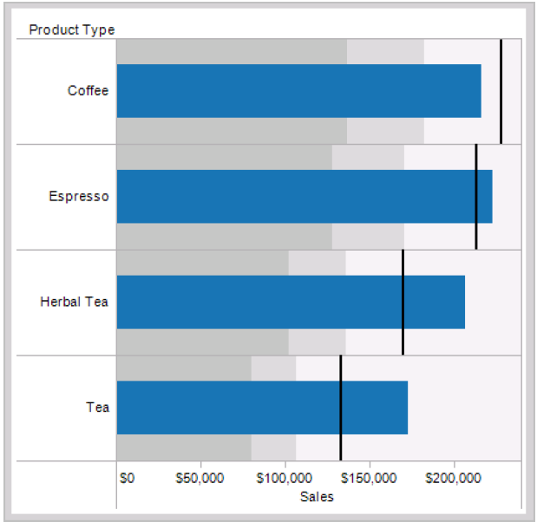
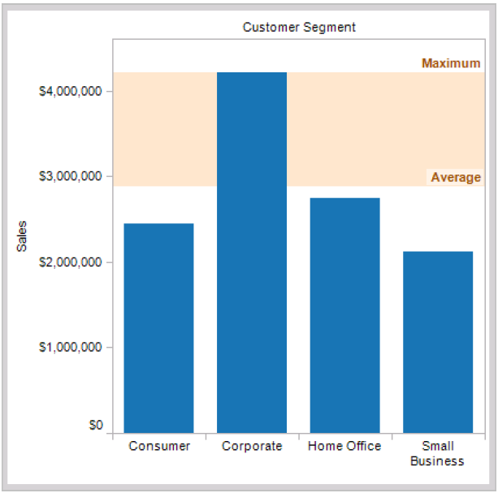
Reference Lines and Banding
Lines
Distribution
Bands

Slide 27
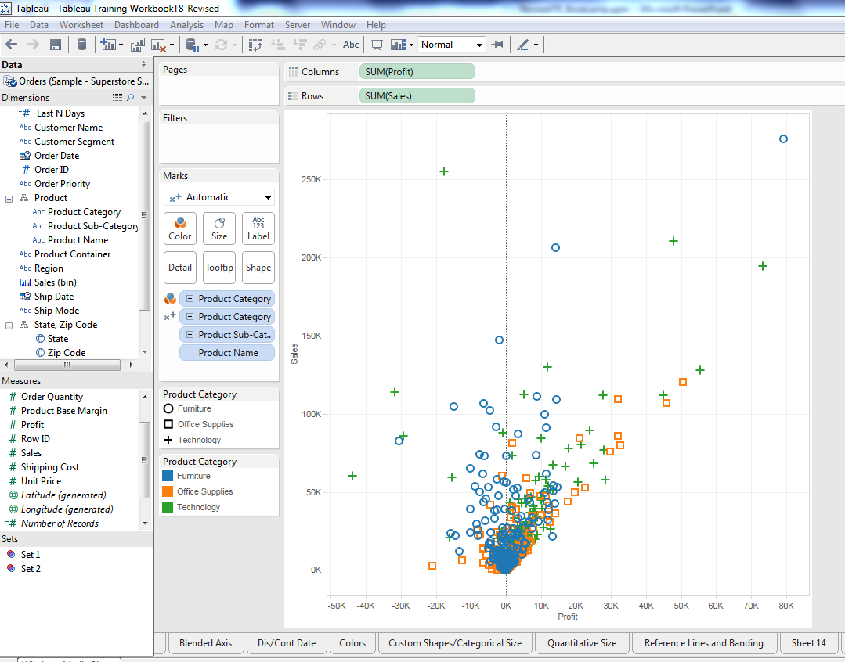
Activity #2 Create a visualization detailing sales and profit by category – 10 Minutes
Drag Profit & Sales into Row and Column
Drag Category into Color
Drag Sub-Category into level of detail

Slide 28
Chart Type & Design Considerations

Slide 29
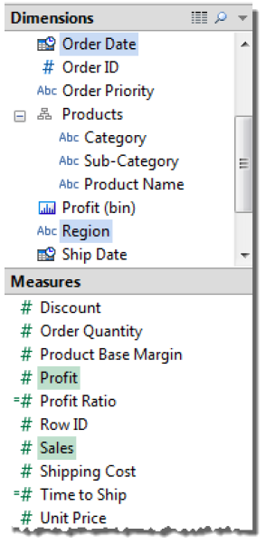
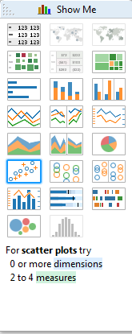
Show Me!
Hold CTRL and click a combination of dimension(s) and measure(s)
Chart options with appear in Show Me!

Slide 30
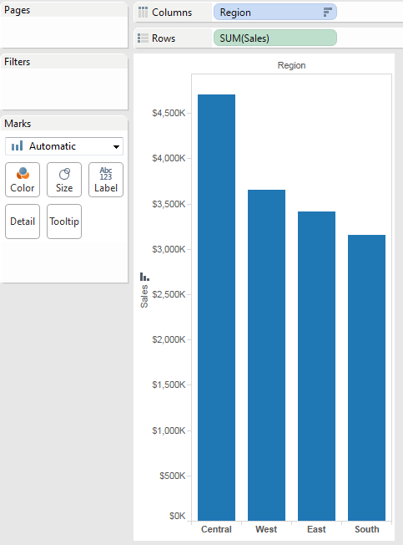
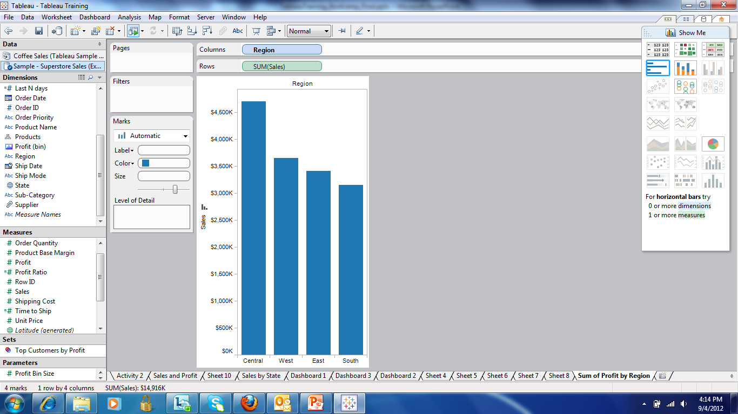
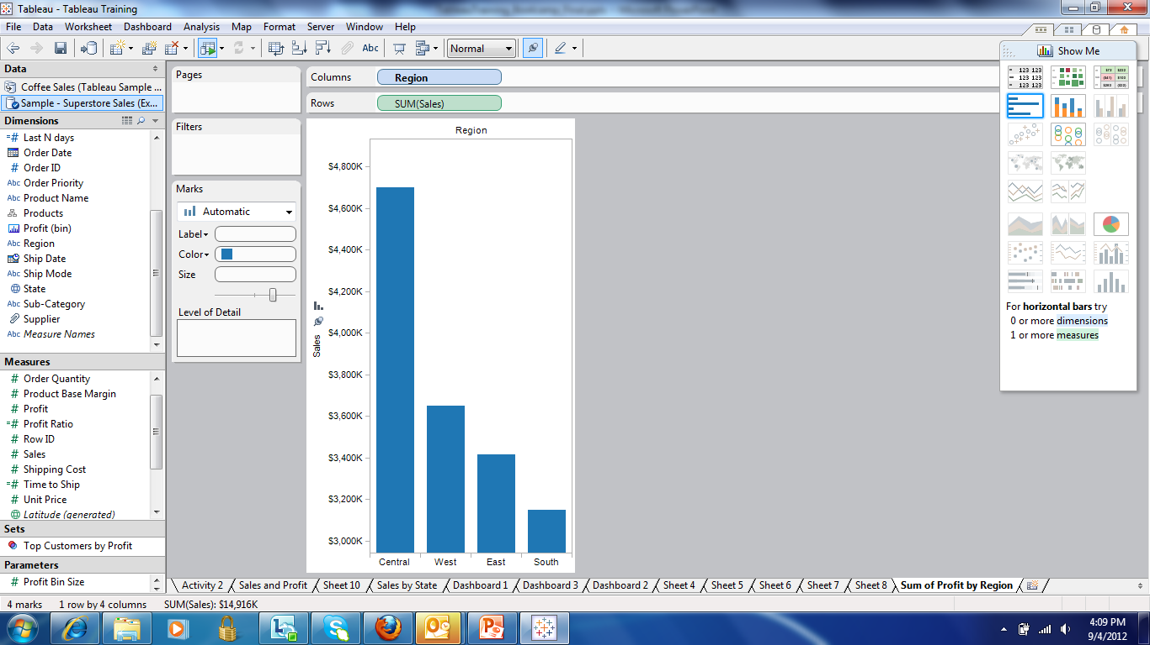
Bar Chart
Leading Practices
Most effective medium for uni-dimensional categorical comparisons
Sort in order to show ranking of elements
Comparison is facilitated by common base of reference
Use 0 for axis floor to ensure data veracity

Slide 31
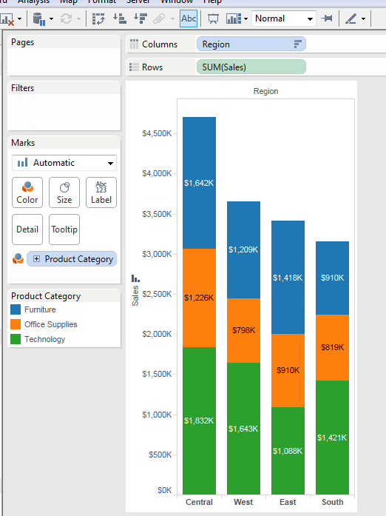
Stacked Bar Chart
Leading Practices
Comparing categories within a category
Sort in order to show ranking of elements
Sub-category comparison is diminished through differing baseline reference point
Use data labels to mitigate uneven floors
Use 0 for axis floor to ensure data veracity

Slide 32
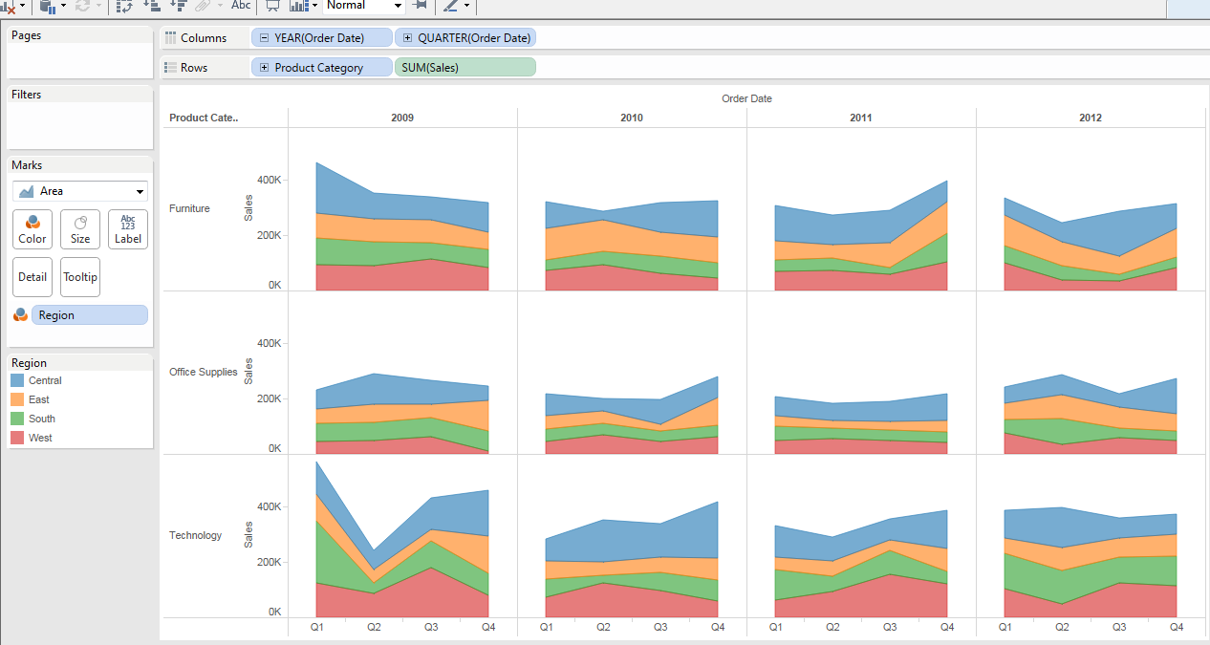
Nested Charts / Trellis / Small Multiples
Leading Practices
Comparing across multiple categories and within a category
Use filtering or highlighting to guide consumer (if using native functionality
Use red circles and analytical paragraphs if exporting to flat medium (ex: PPT or PDF)
Sub-category comparison is nearly impossible
Use highlighted data labels to mitigate

Slide 33
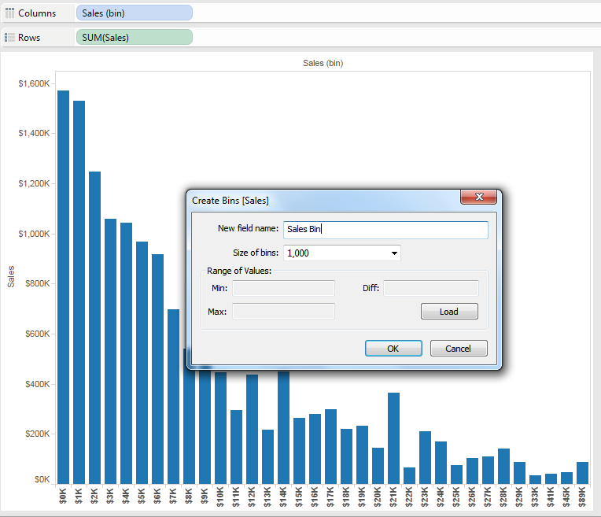
Histogram
Leading Practices
Showing distributions across a category (ex: how much sales volume from high dollar sales vs low dollar sales)
Turning a measure into a dimension
Bins are equal segmentations of the data set (ex: $1,000 increments)
For unequal segmentations (ex: 1-3 years & 4-10 years) use a calculated field

Slide 34
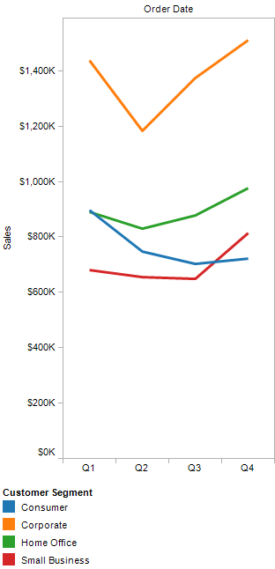
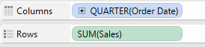
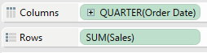
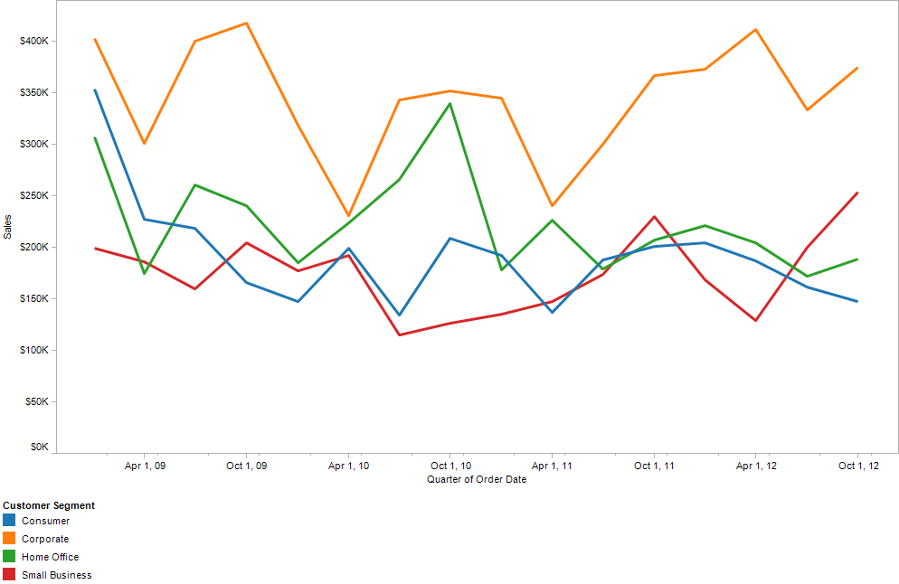
Line Chart
Leading Practices
Dimensional Time Scale
Viewing continuous data sets (most often time series data)
Dimensional time breaks down into discrete entities and sums them (e.g., Q1 sales over 4 years)
Continuous time drills into granularity year, quarter, month, week, day, hour, minute
Allows comparison of different dimensions over same period of time
Continuous Time Scale

Slide 35
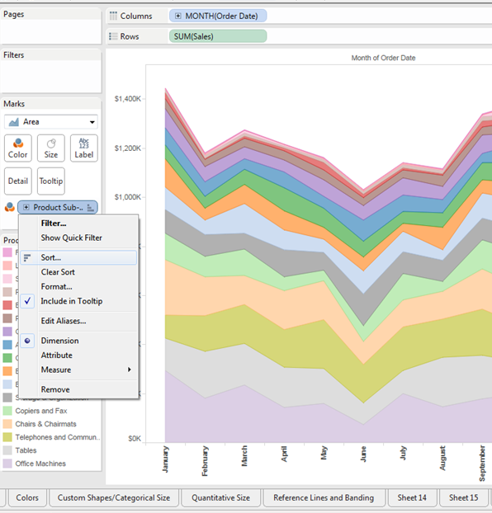
Area Chart
Leading Practices
Similar to a line chart but displays total sum broken out by dimension
Sort data from a high to low to provide additional context
Same calculations based on continuous / dimension date

Slide 36
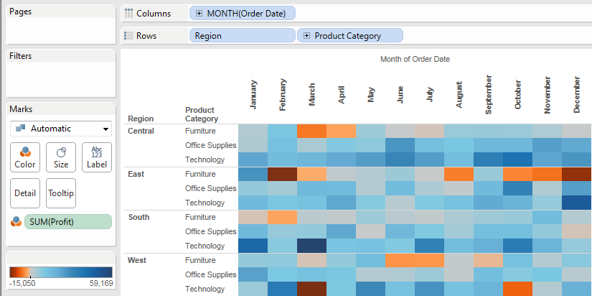
Heat Map
Leading Practices
Displays metric intensity over a dimensional grid
Extremely effective for pinpointing high and low areas
Outstanding method for “data discovery’ analysis

Slide 37
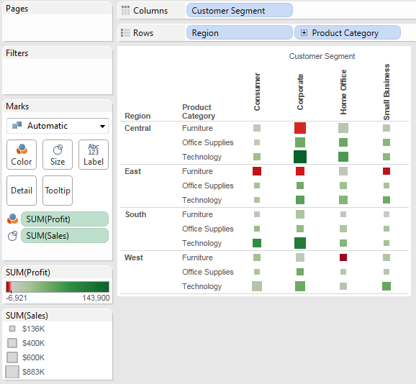
Size-Encoded Heat Map
Leading Practices
Same advantages as heat map but adds 2nd metric measurement
Excellent visualization for finding outliers across 2 metrics

Slide 38
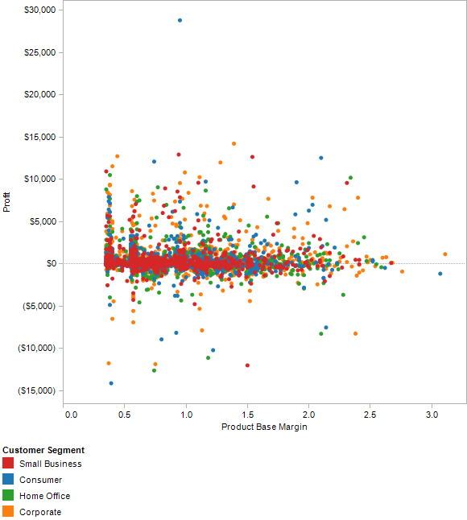
Scatter Plot
Leading Practices
Showing correlation among variables
Showing concentration among variables
Can use up to 5 variables, however recommend using no more than 3 in the following order:
Color
Size
Shape

Slide 39

Bubble Maps
When to use….
Showing multiple values with geo-coded data

Slide 40

Choropleth or Polygon Map
Auto-Generated Measures
Need Geo–Coded Dimension
Leading Practices
Showing geospatial trends
Showing data in the context of built in geocoded census data sets

Slide 41

Text Table
When to use….
Showing a lot of detailed information

Slide 42

Highlight Table
Leading Practices
Showing a lot of detailed information with an aspect of the data color coded for highlights

Slide 43

Gantt Bar Chart
When to use….
Displaying durations over time (e.g. project schedule)

Slide 44

Pie Charts NOOOOOOOOOOOOOOOOOO!!!!!!!!!!!!!!
When to use….
Never…..or when showing proportions with ONLY two variables

Slide 45

Pie Chart Maps NOOOOOOOOOOOOOOOOOO!!!!!!!!!!!!!!
When to use….
Showing proportions with geo-coded data

Slide 46


Bullet Chart
When to use….
When evaluating performance of a metric against a goal and within a distribution

Slide 47

Creating Dashboards
Drag & Drop

Slide 48

Other Dashboard Elements

Slide 49

Activity #3 Create 3-4 Visualizations for a Dashboard – 20 Minutes

Slide 50
Intermediate Features

Slide 51


Formatting

Slide 52

Custom Calculations
Can create new fields based on existing dimensions and measures
Calculation syntax similar to Excel and MySQL and SAS

Slide 53


Annotation
Annotating
Mark = Follows Data
Point = Chart Spot
Area = Chart Area

Slide 54



Tooltips

Slide 55


Dual Axes

Slide 56


Combination Charts

Slide 57

Conditional Filtering

Slide 58






Quick Filtering
Filter Types

Slide 59


Color Legend Highlighting
OR

Slide 60




Actions > Highlights Or Filters
Select Worksheet > Actions
Add Action > Highlight/Filters
Give name
Select source sheet
Select how you want to launch action
Select target sheet
Select fields you want to highlight
4
5
6
7
2

Slide 61

T8 Filters
Gets rid of the old Global Filter, allows you to selectively filter

Slide 62

Extracting and Optimizing Data
Optimizing Data
Extract > Optimize
When to use….
Optimizing moves calculated fields into the extract so they don’t have to be computed locally every time
Each time you optimize the extract, any deleted calculations will be removed fro the extract, new ones will be added, and modified ones will be updated.
When to use…. Done playing with data and views and want to publish and improve speeds and size

Slide 63

Multiple Data Connections
Blue Check = Primary
Orange Check = Secondary
Link = Data Relationship

Slide 64



Animating Through Pages Shelf
1. Drag dimension to Page Shelf
2. Animate design

Slide 65

Saving Your Workbook

Slide 66
Appendix A: Visual Cues

Slide 67

Various Visual Cues (1 of 2)

Slide 68

Various Visual Cues (2 of 2)

Slide 69
Appendix B: Glossary

Slide 70
Glossary (1 of 8)
Action: An action is interactivity that you can add to your views. There are three kinds of actions: Filter, Highlight, and URL.
Aggregation: An aggregation results from a mathematical operation applied to a measure. Predefined aggregations include summation, average, and so on. Dimensions can be converted to measures by aggregating them as a count.
Alias: An alias is an alternative name assigned to a field or to a dimension member. Tableau supports both field aliases and member aliases.
Axis: An axis is displayed in a table when you place a continuous field on the Rows or Columns shelf. The axis labels are given by the name of the measure.
Bookmarks Bookmarks contain the data view from a single worksheet. You can create and display bookmarks using the Bookmark menu. Bookmarks behave like web browser bookmarks. They can be accessed without opening any other document and are a convenient way to quickly display different analyses. You should save bookmarks in the bookmarks folder of the Tableau repository.
Caption: A description of the current view on the active worksheet. For example, “Sum of Sales for each Market”. Captions can be automatically generated or custom. Show and hide the caption by selecting Worksheet > Show Caption
Cell: Any table you create in Tableau has the cell as its basic element. Controlling cells to enhance your data view is useful for text tables and heat maps

Slide 71
Glossary (2 of 8)
Color Legend: The color legend displays the colors associated with a measure or dimension members. The default legend is modified when you place a dimension or a measure on the Color shelf.
Color Shelf: The Color shelf allows you to encode data by assigning different colors to the marks in a data view. The shelf accepts a measures or a dimension. When you place a dimension on the Color shelf, Tableau separates the marks according to the members in the dimension, and assigns a unique color to each member. When you place a measure on the Color shelf, Tableau draws each mark with a different color using a continuous range. In both cases, a legend describes the color encoding.
Columns Shelf: The Columns shelf allows you to create the columns of a data table. The shelf accepts any number of dimensions and measures. When you place a dimension on the Columns shelf, headers for the members of that dimension are created. When you place a measure on the Columns shelf, quantitative axes for that measure are created.
Cross-tab: In Tableau, a cross-tab is another name for a text table. Text tables provide an easy way to display the numbers associated with dimension members.
Custom Geocoding: Tableau comes with built in geocoding data so that you can plot your data on a map. Custom Geocoding is when you add your own location data to extend the built in geocoding.
Dashboard: A dashboard is a collection of several worksheets shown in a single location where you can compare and monitor a variety of data simultaneously.

Slide 72
Glossary (3 of 8)
Data View / View: A data view, also referred to simply as a view, is a representation of your data in a Tableau worksheet or dashboard. You can create data views by placing fields on shelves.
Data window: The Data window displays the fields of the data sources to which Tableau is connected. The fields are divided into dimensions and measures. The Data window also displays custom fields such as calculations, binned fields, and groups. You build views of your data by dragging fields from the Data window onto the various shelves that are a part of every worksheet.
Data Source: To build data views, you must connect to a data source. Tableau supports many standard relational and multidimensional (OLAP) sources. When connected, Tableau does not save a copy of your data. Instead, it saves information about where the data source is located. When you build data views, Tableau sends the appropriate queries to your data source. A convenient location to save data sources is the data sources folder of the Tableau repository.
Dimensions: Dimensions are independent fields. Dimensions typically hold discrete data such as hierarchies and members that cannot be aggregated. Examples of dimensions include dates, customer names, and customer segments. Tableau does, however, support continuous dimensions.
Encoding: In Tableau, encoding refers to a particular visual representation of your data. You can encode your data by color, shape, size, and path using the associated worksheet shelves.
Fields: Field is another name for a dimension or a measure. All databases contain fields. Fields contain data. For relational data sources, fields are the columns of a table. For multidimensional (OLAP) data sources, fields are the dimensions of a cube. Each dimension or column contains a unique attribute of the data such as customer name, sales, product type, and so on.

Slide 73
Glossary (4 of 8)
Field Label: Field labels are titles that indicate the fields that are used in a view. For example, in a view that has rows for East, Central, and West might have a Region field label at the top of the column indicating that each row is a member of the Region field.
Filters Shelf: The Filters shelf allows you to exclude data from a view. You can filter data using measures, dimensions, and both measures and dimensions at the same time. You can filter data based on the fields that make up the columns and rows of the table. This is called an internal filter. You can also filter data based on fields that do not compose the table. This is called an external filter.
Format window: The Format window is a pane that, when open, displays on the left side of the workbook. The Format window contains formatting settings that control the entire worksheet as well as individual fields in the view.
Group: A group is a field consisting of dimension members that have been combined into higher level categories. For example, a dimension that contains states could be grouped into regions using Groups. Groups are marked with a paper clip icon in the Data window.
Headers: Headers are displayed in a table when you place a dimension on the Rows or Columns shelf. The header labels are given by the dimension member names.
Level of Detail Shelf: The Level of Detail shelf allows you to separate the marks in a data view according to the level of detail (members) of a dimension. The shelf works only if your data are aggregated. If your data are disaggregated, then it isn't possible to separate the marks into additional levels of detail. Additionally, placing a measure on the shelf has no effect on the table structure because measures do not contain members.

Slide 74
Glossary (5 of 8)
Marks: Marks visually represent one or more rows in a data source. Mark types can be a bar, line, square, and so on. You can control the type, color, and size of marks. Tableau can automatically select a mark type, or you can manually select the mark type from the Mark menu.
Measures: Measures are fields that are dependent variables. They are typically quantitative fields or calculated fields like sales, temperature or frequency. Discrete measures can also be created in Tableau.
Pages Shelf: The page shelf lets you split a view into a sequence of pages based on the members and values in a discrete or continuous field. Adding a field to the Page shelf is like adding a field to the Rows shelf except a new page is created for each new row.
Pane: Tables consist of one or more panes. The number of panes in a view depends on the number and type of fields placed on the Rows and Columns shelves.
Path Shelf: The Path shelf allows you to encode data by connecting marks using a particular drawing order. The shelf accepts measures and dimensions. Dimensions connect the marks according to the members in the dimension. If the dimension is a date, the drawing order is given by the date order. If the dimension holds words, the line is drawn based on the order of the words in the data source. Measures connect the marks according to the values of the measure. The measure can be aggregated or disaggregated.

Slide 75
Glossary (6 of 8)
Query: Tableau communicates with your databases with queries. Queries are questions that databases can understand and answer. Common query languages include SQL and MDX. Every time you build a view of your data, Tableau translates your actions into queries and retrieves the requested information from the data source. If you are building a dense data view, you can turn queries off until all desired fields are placed on shelves.
Relational Data Source: In Tableau, a relational data source can be an Excel workbook, an Access database, a comma delimited text file, a MySQL database, an Oracle database, a SQL Server database, a Firebird database, a PostgreSQL database, or a Tableau Data Extract file.
Repository: The Tableau repository holds workbooks, bookmarks, and data sources. It is located in a folder called My Tableau Repository inside of your My Documents folder.
Rows Shelf: The Rows shelf allows you to create the rows of a data table. The shelf accepts any number of dimensions and measures. When you place a dimension on the Rows shelf, headers for the members of that dimension are created. When you place a measure on the Rows shelf, quantitative axes for that measure are created.
Set: A set is a custom field you create by filtering existing dimensions. They appear at the bottom of the Data window in the Sets area. The three main uses of a set are to create a subset of the data, apply a numerical or a top N filter, and to create unique encodings. You can use sets in data views just like any other dimension.
Shape Legend: The shape legend displays the shapes associated with dimension members. The legend appears on worksheets that have a dimension placed on the Shape shelf.

Slide 76
Glossary (7 of 8)
Shape Shelf: The Shape shelf allows you to encode data by assigning different shapes to the marks in a data view. The shelf accepts dimensions only. When you place a dimension on the shelf, Tableau separates the marks according to the members of the dimension, and a legend describes the encoding. You cannot place a measure on the shelf because measures do not contain members.
Shelves: You build views of your data by placing fields onto the shelves that are a part of every worksheet. Some shelves are available only when certain mark types are selected. For example, the Shape shelf is available only with the Shape mark type.
Size Shelf: The Size shelf allows you to encode data by assigning different sizes to the marks in a data view. The shelf accepts measures and dimensions. When you place a dimension on the shelf, Tableau separates the marks according to the members in the dimension, and assigns a unique size to each member. When you place a measure on the shelf, Tableau assigns a different size to each mark using a continuous range.
Table: The visual presentation of a data view is contained within a table. Tables consist of panes, headers, axes, and cells.
Text Shelf: The Text shelf allows you to view the numbers associated with a data view, and to encode data by assigning text labels to the marks. The most common view using the Text shelf is a text table. The shelf accepts measures and dimensions.

Slide 77
Glossary (8 of 8)
Undo/Redo: You can undo any action in Tableau by clicking Undo on the toolbar. Likewise, you can redo any action by clicking Redo on the toolbar. Using Undo and Redo, you can quickly return to a previous view or you can browse all the views of a data source that you have created. The undo/redo history is not saved between Tableau sessions.
Workbooks / Packaged Workbooks: Workbooks hold one or more worksheets and dashboards. By saving a workbook, you can save all open sheets in one file that can then be easily shared.
Worksheets: Worksheets hold your data views. You can save individual worksheets as bookmarks. Each worksheet can be connected to only one data source. However, different worksheets in a workbook can be connected to different data sources.

Slide 78

Copyright © 2010 Deloitte Development LLC. All rights reserved.

